Slide 1
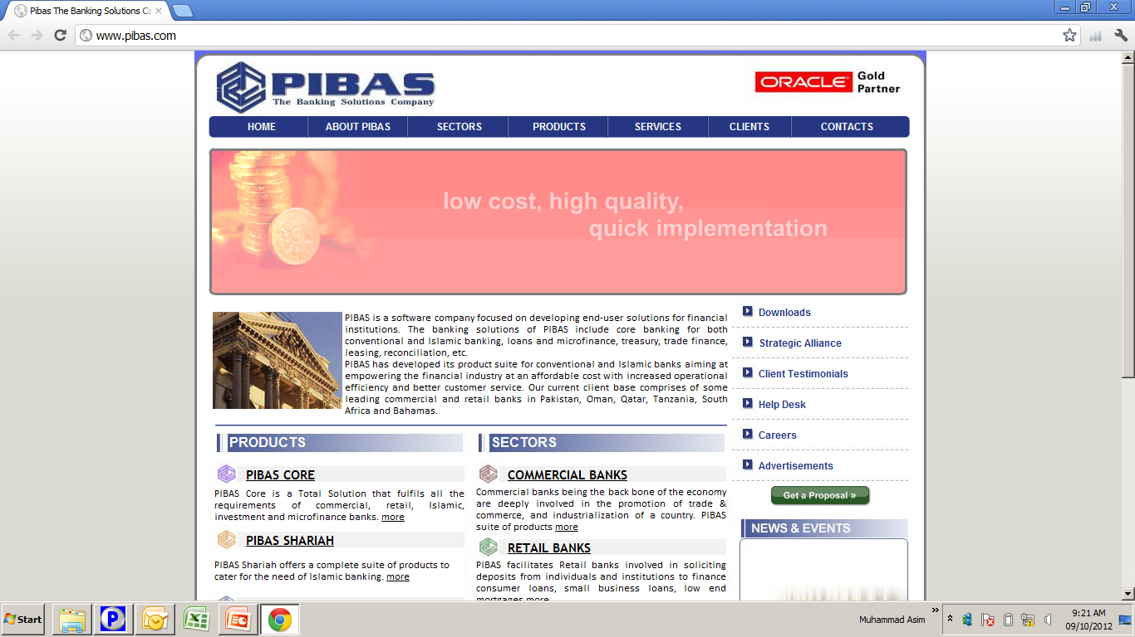
Customer Account Opening Part 1
Account Opening Part 1
In this Module we will learn, how we will open customer accounts into systems. This is the process, that will be executed after Generation of Business Relationship Number that we have already trained in our last Training Session.
In the first phase of this module, we will learn Opening, Maintenance, Supervision, Account Locator, Account List / Report, Special Condition Maintenance, Interest Rate Maintenance and Accrued Interest Adjustment etc.

Slide 2
Contents
Customer Account Opening Part 1
Opening
Maintenance
Supervision
Account Locator
Account List / Report
Special Condition Maintenance
Interest Rate Maintenance
Accrued Interest Adjustment

Slide 3
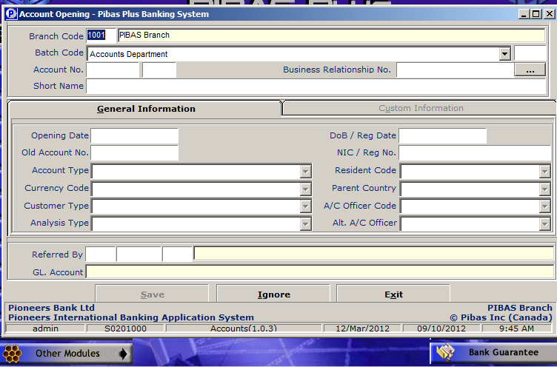
Opening
Customer Account Opening Part 1
In this process, we will learn, how to open a customer account of different natures by adding following important fields into the system.

Slide 4
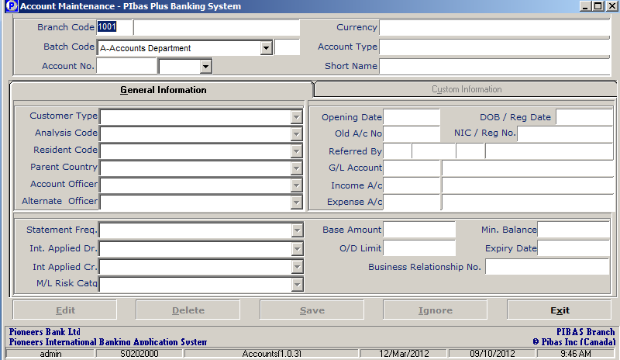
Maintenance
Customer Account Opening Part 1
In this process, we will learn, how to edit a customer account with respect to any field (s) in case of any rectification required or as per request of the customer.

Slide 5
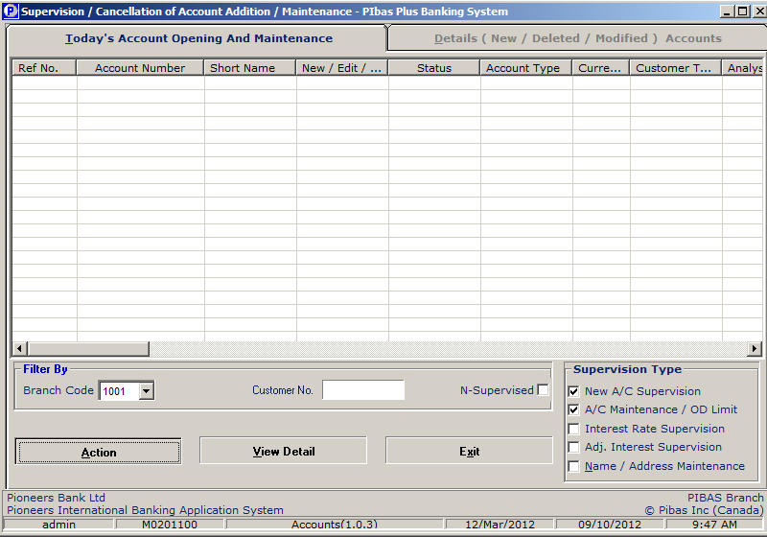
Supervision
Customer Account Opening Part 1
In this process, we will learn, how a Supervisor will authenticate / supervise non-financial transaction of an opening of account or maintenance of account. Same user cannot be supervise his / her own transaction.

Slide 6
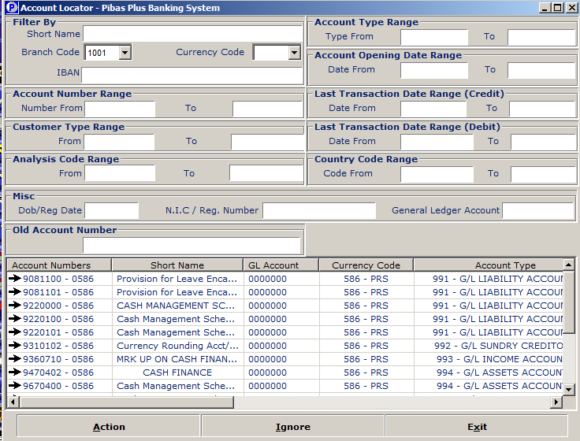
Account Locator
Customer Account Opening Part 1
In this process, we will learn, how we will locate an account (customer or general ledger / internal account) through different queries / hints i.e. Starting Name, Type, Last Transaction Date etc.

Slide 7
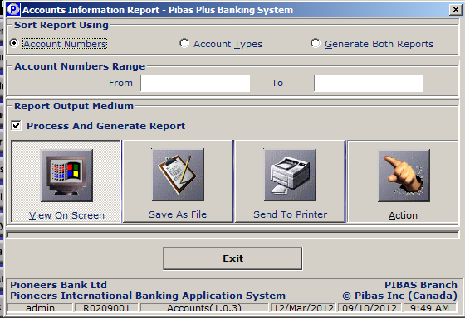
Account List / Report
Customer Account Opening Part 1
In this process, we will learn, how we generate list of accounts whether a customer or internal account by using different conditions i.e. Account Type, Account Numbers etc.

Slide 8
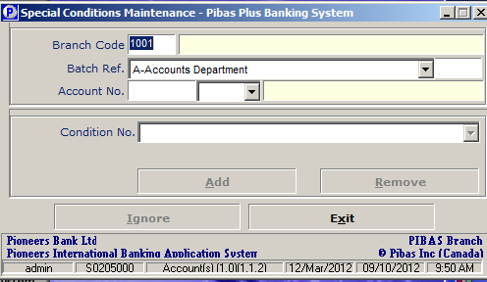
Special Cond. Maint.
Customer Account Opening Part 1
In this process, we will learn, how we will add / remove any special condition from an account (Customer of Internal) . Special Condition is the condition that can change behavior of an account.

Slide 9
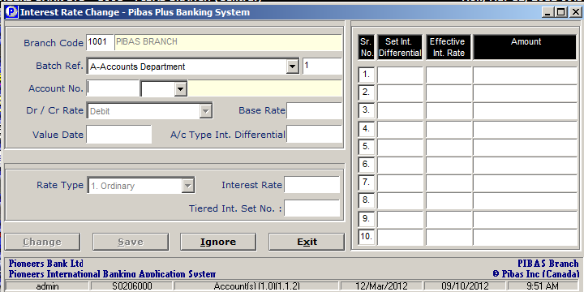
Int. Rate Maintenance
Customer Account Opening Part 1
In this process, we will learn, how we will change Interest Rate (Debit or Credit) of an account. Different facilities available here e.g. Value Date, Split Rate etc.c

Slide 10
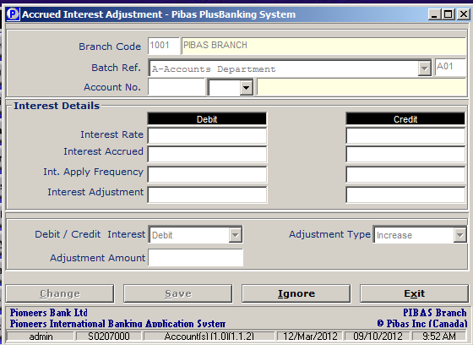
Accrued Int. Adj.
Customer Account Opening Part 1
In this process, we will learn, how we will change Accrued Interest into system that will be credited / debited at the End of Day Processing. This option is normally used at the time of closure of account as we cannot close an account until and unless any Credit / Debit Accrued Interest is not removed / posted into that account.

Slide 11
Customer Account Opening Part 1
Hand-On Training

Slide 12
Customer Account Opening Part 1
Question & Answers

Slide 13
Customer Account Opening Part 1
Please provide your Precious Suggestions for further enhancement and improvement of system that will be part of minutes / conclusion of this Training Session. Minutes / Conclusion will be emailed to you today.

Slide 14
Customer Account Opening Part 1
Many thanks for your precious & active participation and your worthy suggestions or queries are always welcomed by the Trainer.

